Slide 1
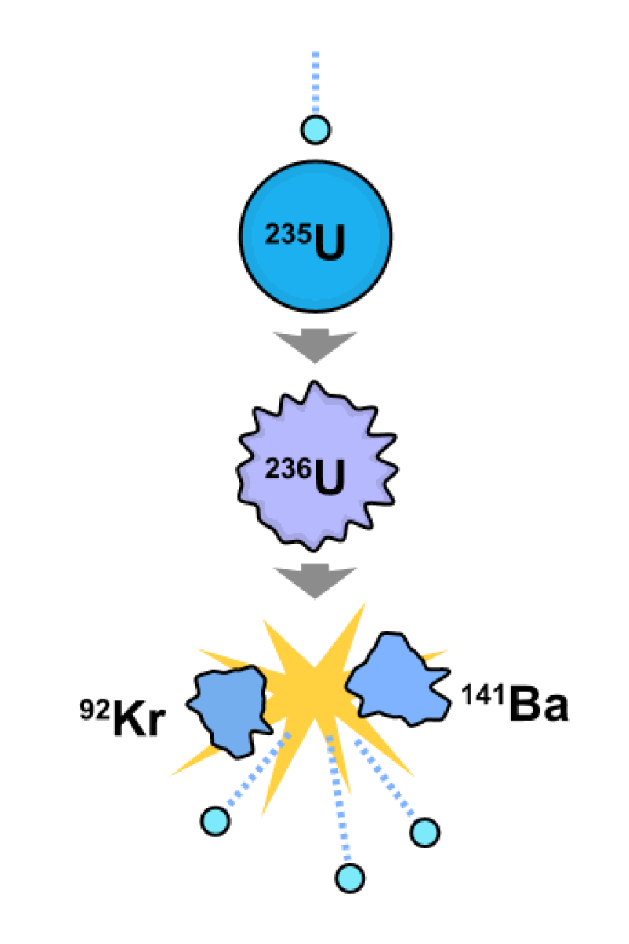
Nuclear Fission Power
Ryan Muller

Slide 2
Review
Fuel cycle
  Mine natural uranium
  Enrich uranium to U235
  Fission reactions in a reactor
  Power turbine with heat to make electricity
  Cool then store spent fuel
What are the problems?
Can we do better?

Slide 3
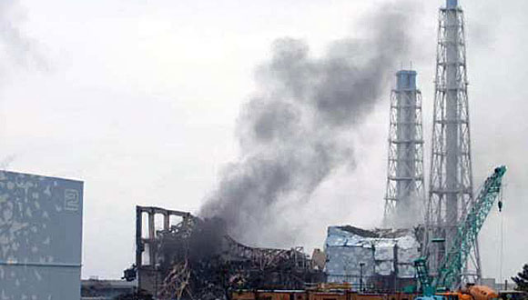
I: Understanding Fukushima
http://www.latimes.com/news/nationworld/world/la-fgw-japan-quake-reactors-smoke-20110322,0,2650127.story

Slide 4
Events at Fukushima
Fukushima plant: six boiling water nuclear reactor units
Earthquake was 7 times more powerful than what the plant was designed to handle; tsunami higher than designed for
Power failures caused problems with cooling
Fire and explosions in spent fuel pool
Notes:
How long does spent fuel need to cool?

Slide 5

Biological Effects of Radiation
Ionization caused by at least 32 eV of energy
X-rays, gamma rays, and neutrons penetrate tissue
Genetic vs. somatic radiation effects
SI unit for dose: gray (1 Gy = 1 J/kg), dose equivalent: sievert (Sv) or rem
http://kjpwv.wordpress.com/2010/07/08/three-eyed-fish-are-coming/

Slide 6
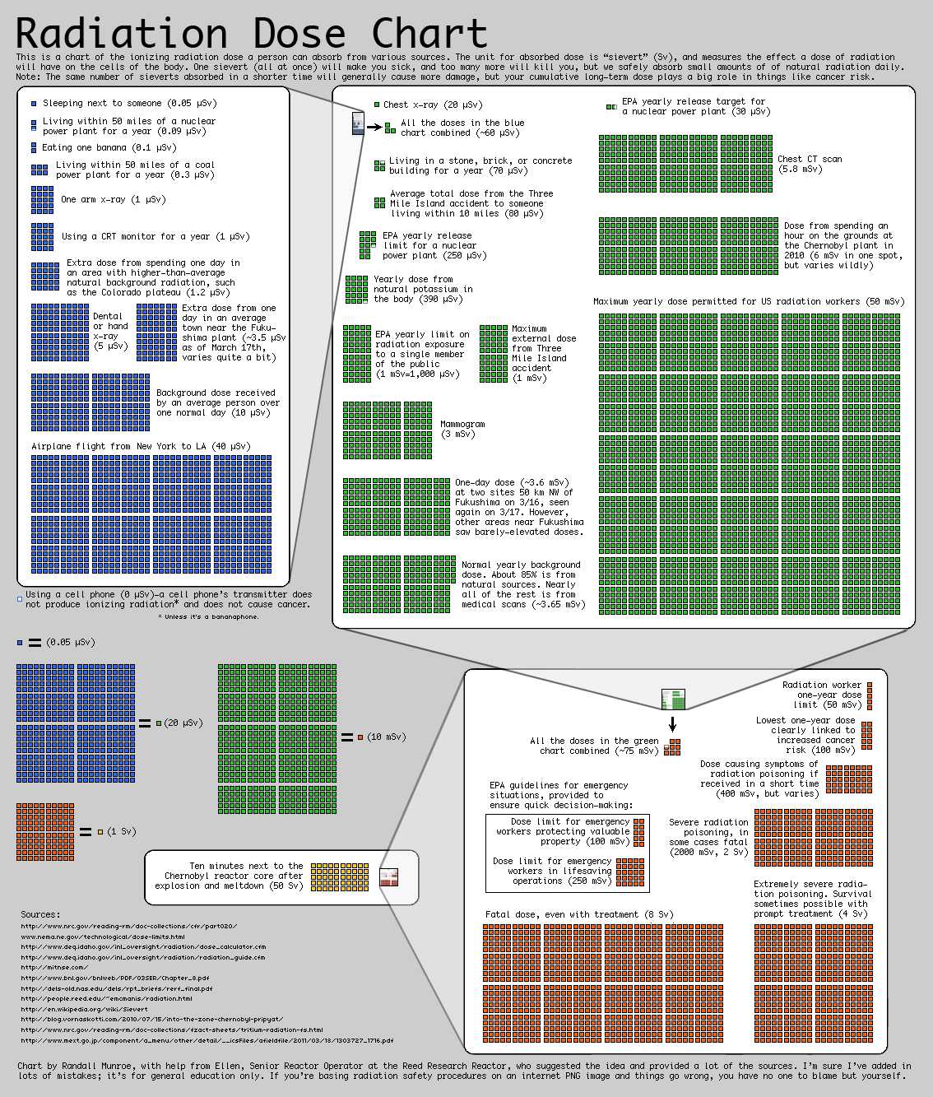
Radiation
http://xkcd.com/radiation/

Slide 7
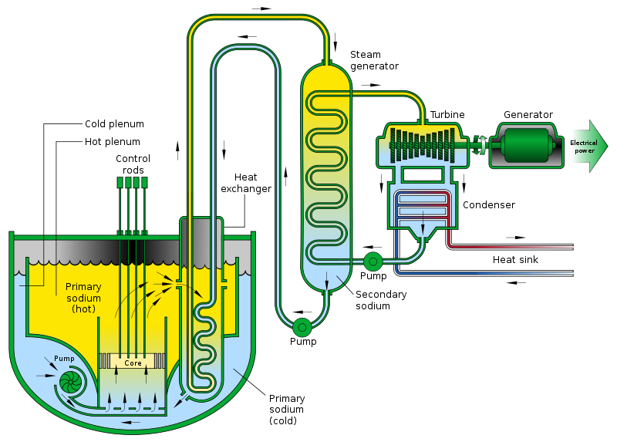
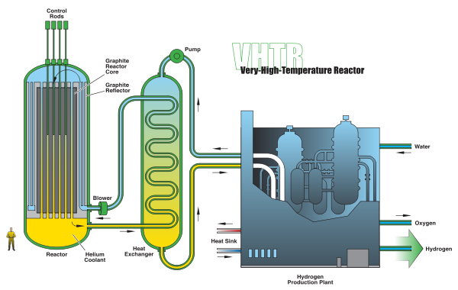
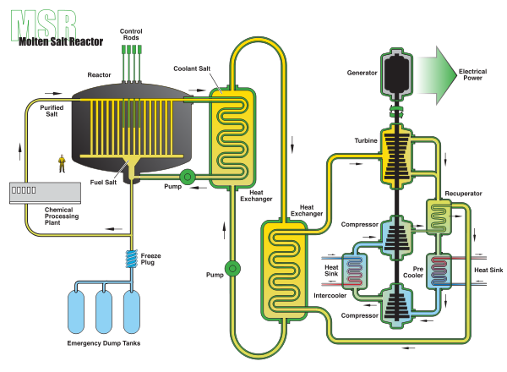
II: Reactor Designs

Slide 8
Types of reactors:
Fast vs. Thermal
Fast
  High energy neutrons due to
  More fuel used
Thermal
  A good moderating material causes slower
  Less fuel used

Slide 9
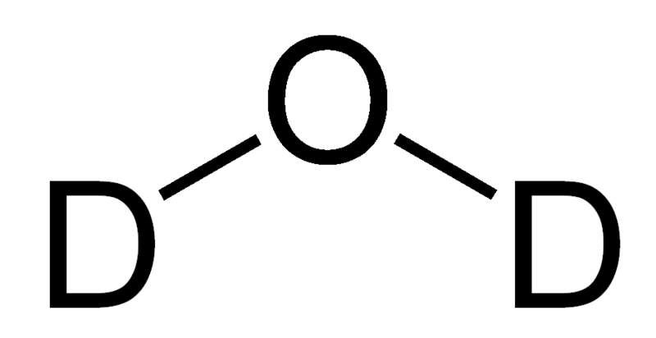
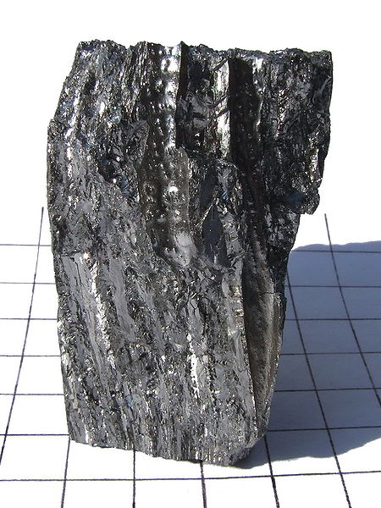
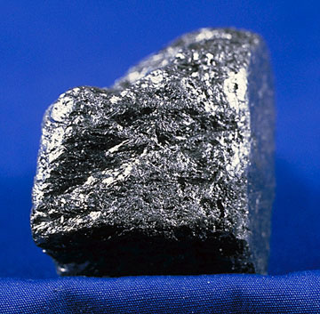
Types of reactors:
Moderators and coolants
Moderator
  Light water
  Heavy water
  Graphite
  Beryllium
Coolant
  Light water
  CO2
  He
  Liquid sodium
http://commons.wikimedia.org/wiki/File:Deuterium-oxide-2D.PNG
http://en.wikipedia.org/wiki/File:Be-140g.jpg
http://en.wikipedia.org/wiki/File:GraphiteUSGOV.jpg
Notes:
Total of six classes of GenIV reactors

Slide 10
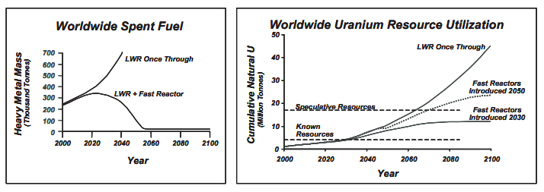
Generation IV reactors
Close the fuel cycle
Inherent safety features
More efficient and economical
http://nuclear.energy.gov/genIV/documents/gen_iv_roadmap.pdf

Slide 11
Notes:
Fuel dissolved in salts, low vapor presssure; “good neutron economy”, thermochemical hydrogen production, inherent safety (less volatile fission products, drainage, passive cooling), can use thorium --

Slide 12
Sodium-cooled fast reactor (SFR)
Notes:
Successor of integral fast reactor
One of three gen 4 fast breeder reactors: gas (=helium), lead
1200 MW SFR at SuperPhenix

Slide 13
http://en.wikipedia.org/wiki/File:Very_High_Temperature_Reactor.svg
Notes:
Can produce hydrogen, electricity or nuclear heat; a graphite-moderated, helium-cooled reactor with thermal neutron spectrum; prismatic block core or pebble bed core ; passive safety

Slide 14
Where to go?
Much R&D to go for Gen IV reactors, but money is needed
  US has been mostly idle for a long time
  Japan events have reduced support for nuclear power
  China announced freezing nuclear approvals on 16 March
Subcritical reactors, travelling wave reactors?

