Slide 1
Nuclear Energy
Ryan Muller

Slide 2
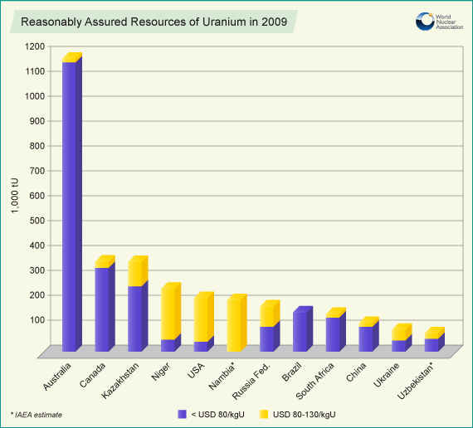
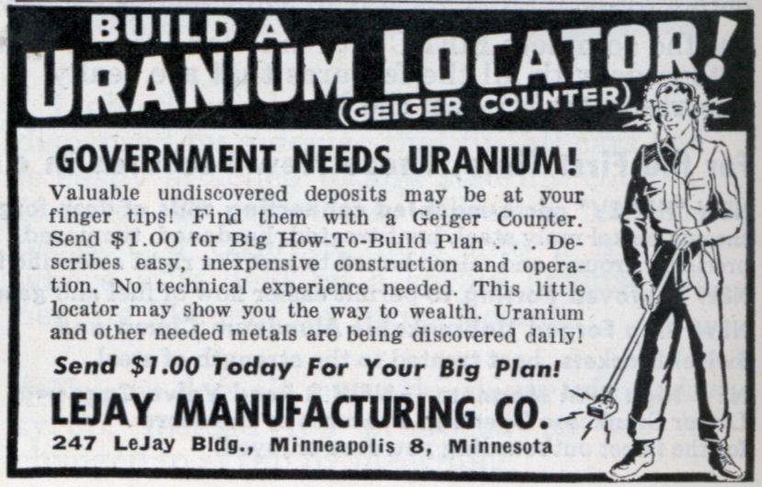
Fuel for fission: Uranium
Plutonium – artificial byproduct of nuclear reactions
Thorium?
http://www.world-nuclear.org/info/inf75.html
http://watd.wuthering-heights.co.uk/nuclear/images/uranium-map.gif

Slide 3
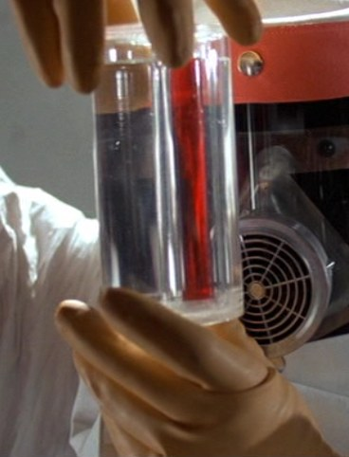
Enrichment
U-235 is fissile, but U-238 is far more common.
Enrichment brings concentration from 0.7% to around 3% for nuclear reactors. (90%+ for nuclear weapons)
Gas diffusion, centrifuge separation, laser separation
http://www.theonion.com/video/report-finds-troubling-rise-in-teen-uranium-enrich,19175/
http://backtothefuture.wikia.com/wiki/Plutonium

Slide 4
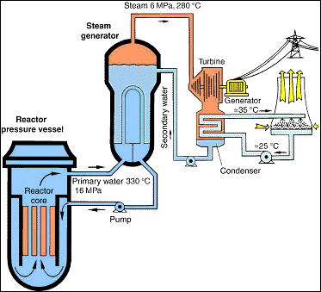
Types of Reactors
Thermal reactor
  Light water reactor
    Pressurized water reactor
    Boiling water reactor
  Molten salt, pebble bed
Fast reactors
  Liquid metal cooled reactor
Hybrid reactors?
Metrics of success: burnup, what kind of fuel can be used, safety
http://www.euronuclear.org/info/energy-uses.htm

Slide 5
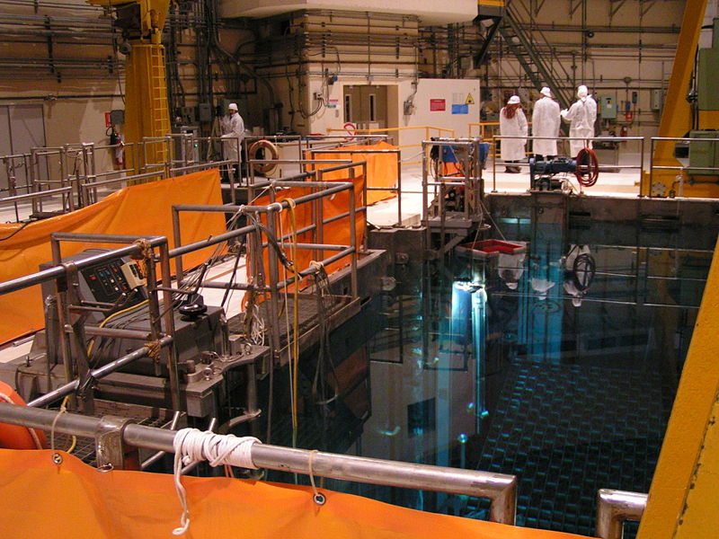
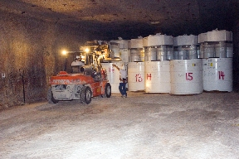
Safety, Waste, Etc.
Many products of fission; called spent fuel when non-reactable
http://en.wikipedia.org/wiki/File:Carso_Fuel_pool.jpg
http://upload.wikimedia.org/wikipedia/commons/e/e9/WIPP-04.jpeg

Slide 6
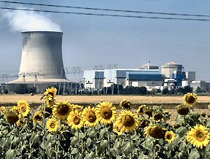
Limits to nuclear fission
Total amount of available fuel
  80 years at current usage
High capital cost of facilities
Policy
http://en.wikipedia.org/wiki/File:Nuclear_Power_Plant_2.jpg

Slide 7
Questions & Further Work
What is the long-term yield from nuclear fission?
What gains can be made in fission due to advances in technologies (in reactors, enrichment, etc.) ?
Understand the physics of nuclues interactions related to fission
What are the byproducts of fission?

