Slide 1
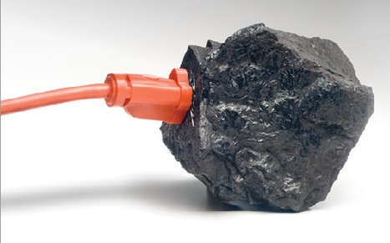
Coal
Cassandra Gamm
image: www.publicradio.org/columns/sustainability/greenwash/coalplug.jpg
Notes:
The advantages and disadvantages for various stakeholders (industry, public, environment)
The basic physics of the issue or technology; historical usage and trends, where appropriate
Q: What are the current EPA regulations regarding solid coal waste?
Environmental impacts on low income communities (South Carolina & China)

Slide 2
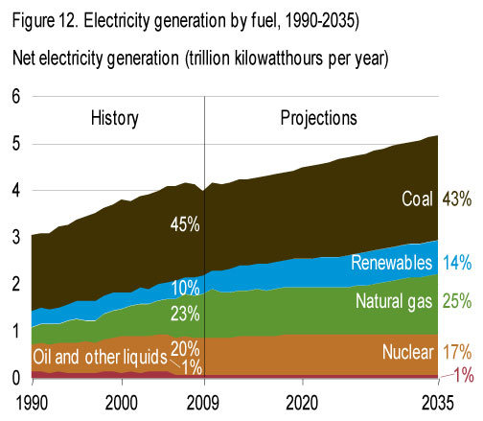
US electricity generation, by fuel
Image: http://www.eia.doe.gov/forecasts/aeo/early_elecgen.cfm

Slide 3
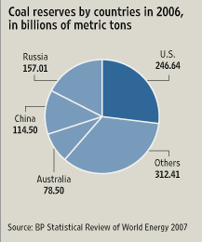
Advantages of Coal
Coal is Cheap and Plentiful
Image: http://www.eia.doe.gov/cneaf/electricity/epm/epm_sum.html
Notes:
MMBtu = British Thermal Unit

Slide 4
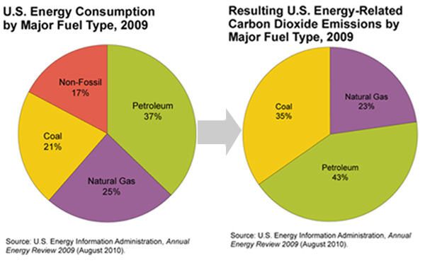

Slide 5
Disadvantages
CO₂ emissions
Health impacts
Environmental impacts
  Acid Rain
  Air pollution
  Water pollution
Image: http://www.ucsusa.org/assets/documents/clean_energy/Coal-power-in-a-warming-world.pdf
Notes:
Appalachia & China

Slide 6
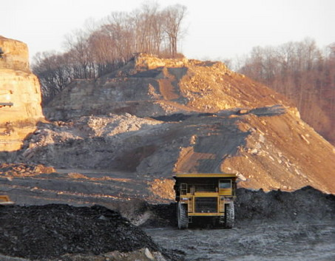
Mining
Mountaintop Removal
  Appalachian region
    Erosion
    Water pollution
    Noise
Underground mining
  China
Image: http://blogs.wvgazette.com/coaltattoo/2009/04/08/peak-coal-goat-ropes-and-manchins-energy-bill/
Notes:
Longwall mining: A modern method of underground coal mining that implements a shearer with a long face of roughly 1000 feet in length. The coal sheered of the wall of the mine is removed from the mine by conveyor belt. This type of mining poses little risk to the worker.
Continuous mining: Another modern technique that uses a machine with a steel rotating drum that scrapes off coal with metal attached to the drum. This method also poses little risk to the miner.

Slide 7
Coal is Complex
Image 1: Schweinfurth, Stanley. An Introduction to Coal Quality. The National Coal Resource Assessment Overview, Chapter C. USDI, USGS. 2009 & Robert Warren’s presentation
Image 2: http://news.bbc.co.uk/2/hi/sci/tech/4468076.stm

Slide 8
Health & Environmental Effects
Images: Laid to Waste, March 2000 and http://www.ucsusa.org/assets/documents/clean_energy/Coal-power-in-a-warming-world.pdf

Slide 9
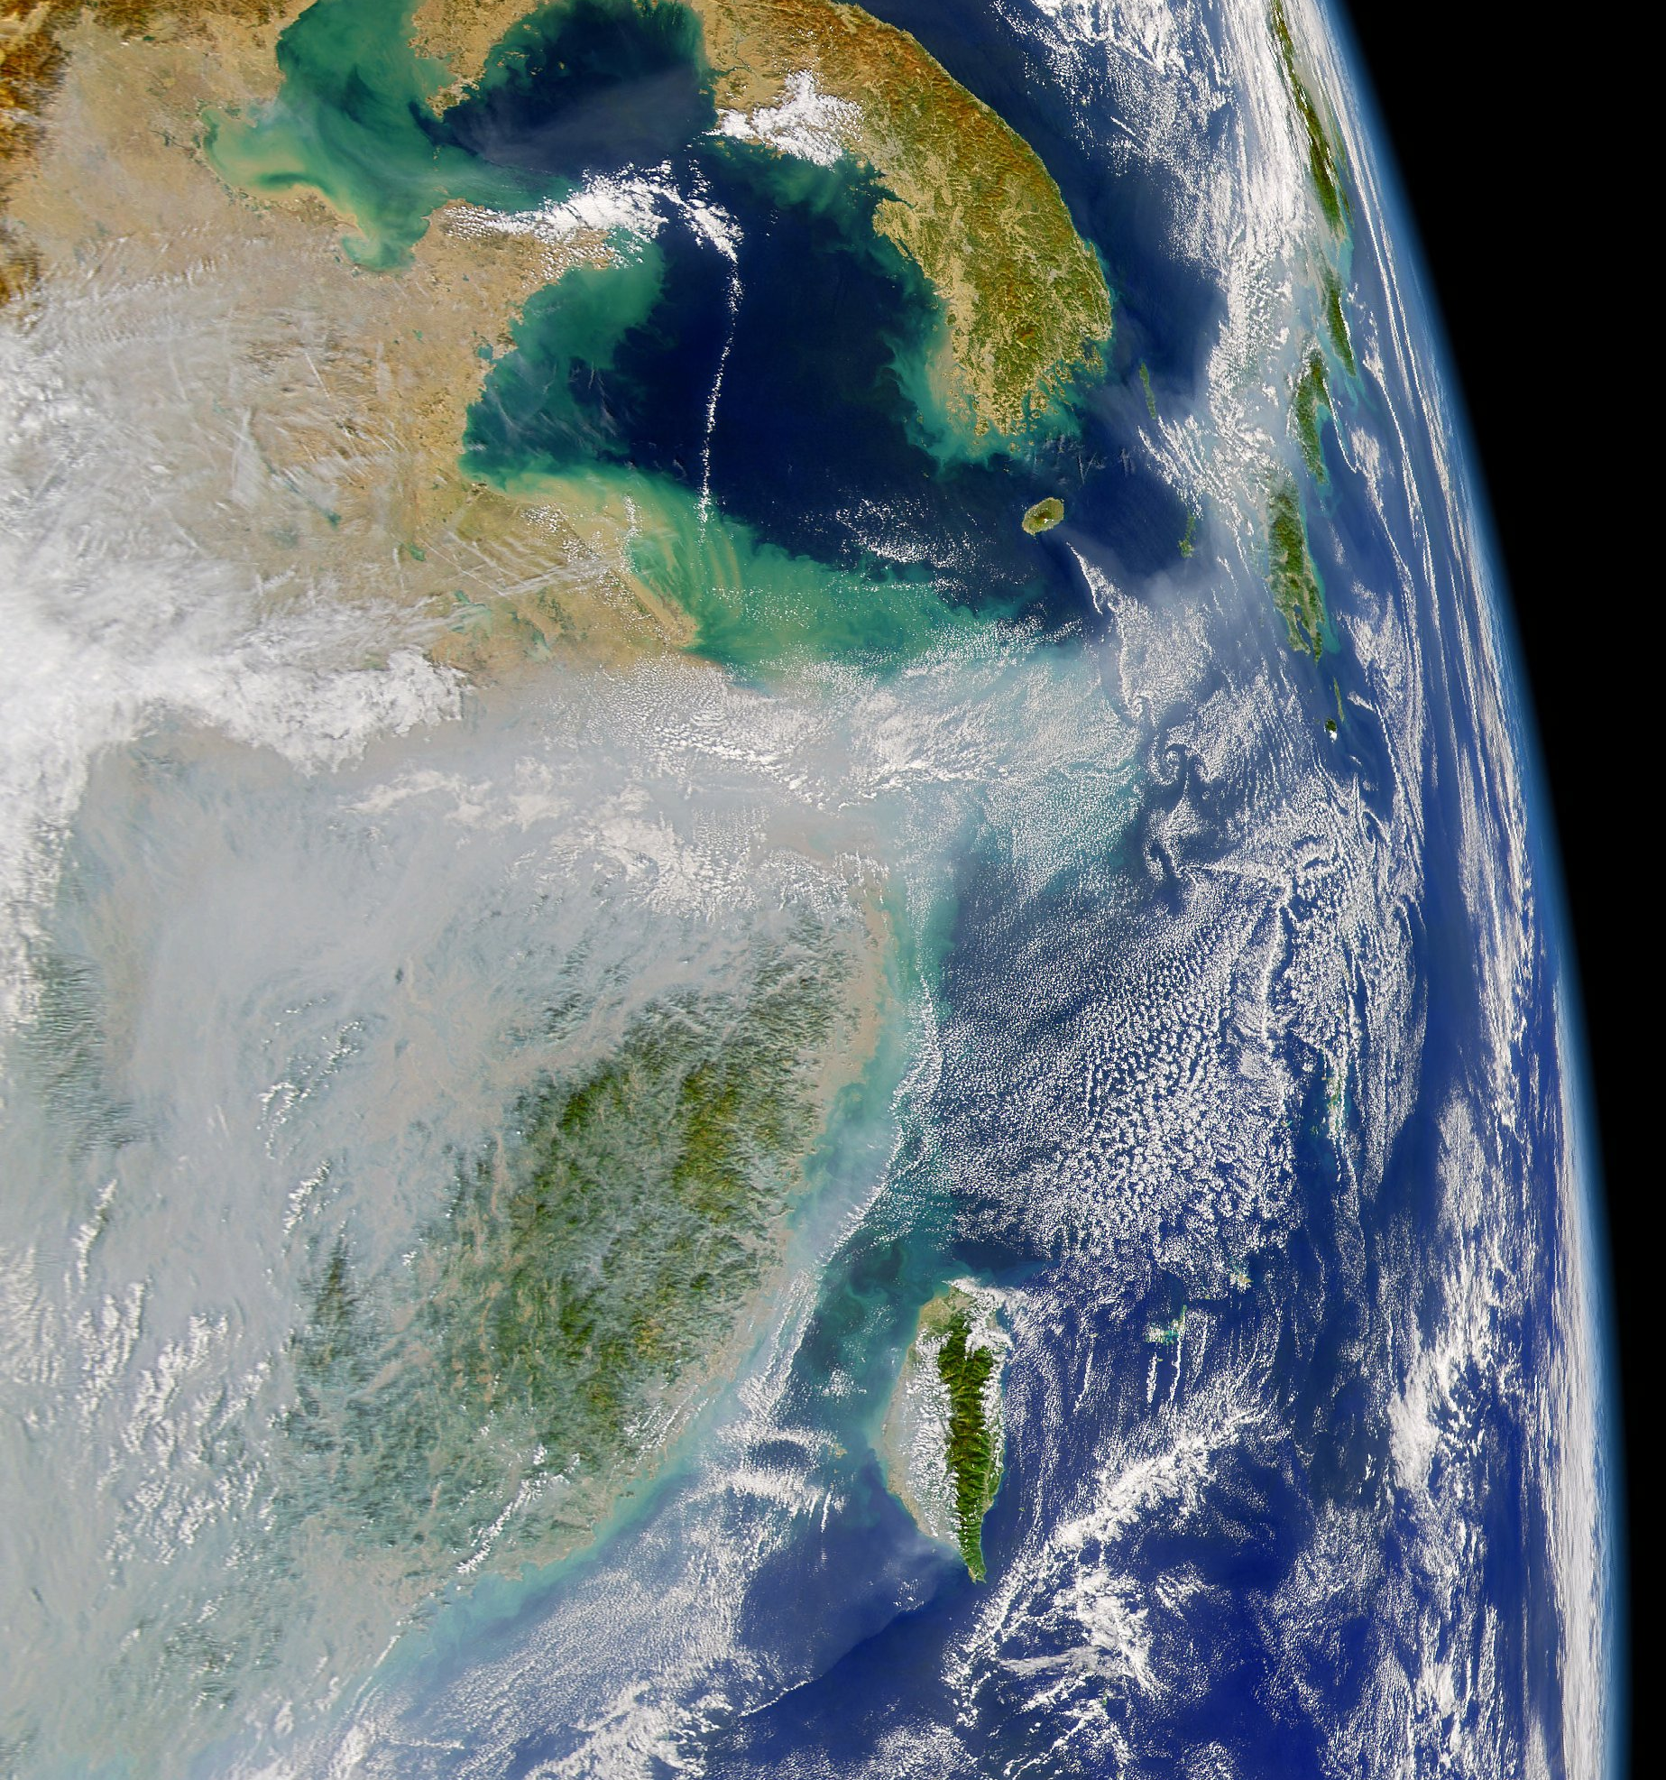
Global Environmental
Impacts
October 22nd, 2004
Image: http://www.nasaimages.org/luna/servlet/detail/nasaNAS~10~10~68670~173649:Particle-Pollution-in-Eastern-China
Notes:
The atmosphere is a globally shared natural resource, and this image illustrates the point. A pool of air pollution has spread out over eastern China and then slipped over the coast like water over a dam. A river of haze flows across the East China Sea past the Korean Peninsula and northeastward toward Japan, where it arcs along the western coastline of the island chain before disappearing out of the scene at upper right.
Rapidly developing China is the world?s second largest consumer of energy (the United States is first), and its primary fuel is coal, most of it burned in inefficient power plants that emit large amounts of carbon emissions and sulfur dioxide, which is the precursor to acid rain. Increasing affluence in the country is also giving rise to a vehicle boom. As cities become more and more clogged with cars, skies become more and more clogged with automobile emissions. Scenes such as this one from October 22, 2004, are not uncommon for this region. With the typical Northern Hemisphere ?Westerlies? flowing from west to east across the mid-latitudes of the Northern Hemisphere, the air pollution from eastern China regularly spreads to South Korea and Japan and out over the Pacific Ocean.
Trans-boundary pollution occurs in many places across the globe, and most nations are simultaneously sources of pollution for countries downwind, and recipients of another country's pollution. Image courtesy the ASA/Goddard Space Flight Center, and ORBIMAGE

Slide 10
China
Coal generates 75% of China’s electricity
China consumes 2.5 billion tons of coal per year, as of 2007.
Images: China’s Energy Paradox, Scientific American

Slide 11

Questions to Pursue
Carbon Capture and Storage (CCS)
  Risks
  Costs and Benefits
  Potential
Zero Emission Coal Plants
  Future of coal in US?
    US FutureGen Coal plant
  China’s GreenGen IGCC Coal Plant (Integrated Gasification Combined Cycle)
image: www.talkgreen.ca

Slide 12
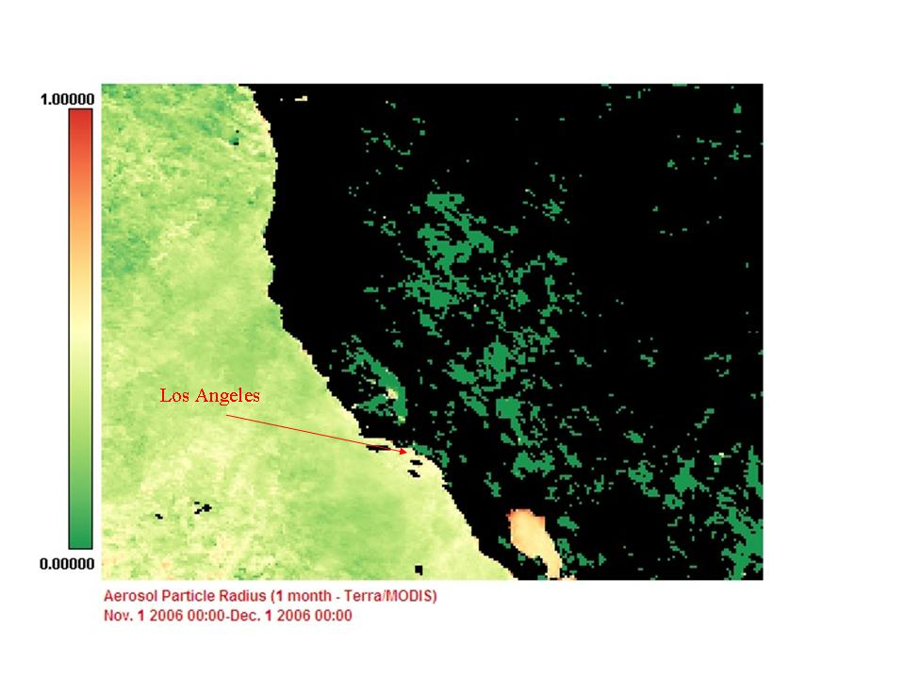
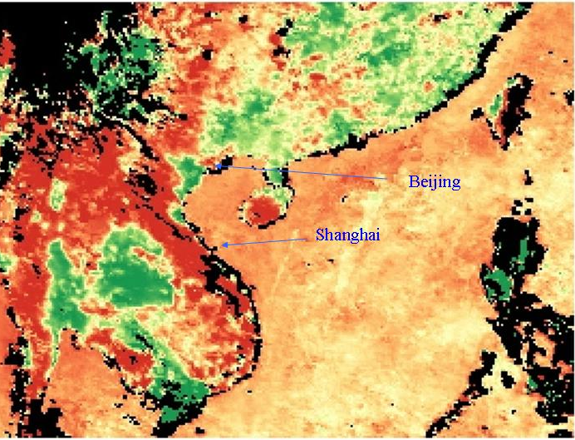
Aerosol Particle Radius: LA vs. China
Nov. 1, 2006 – Dec. 1, 2006
Images: http://disc.sci.gsfc.nasa.gov/oceancolor/additional/science-focus/locus/index.shtml/air_pollution.shtml
Notes:
Coal-fired power plants produce more than 70 percent of China’s elec- tricity—and its infamous smog and child health issues—recently vault- ing China past the U.S. as the world’s largest carbon dioxide emitter. I
As we can see from the graph, the radii of aerosols are larger in China. However, the EPA has determined that smaller particles are actually more harmful than larger particles! Because of this, the EPA did not revise its regulation on particulate matter less than 10 micrometers (PM10 <10μm.) This does not mean that China has ‘better’ pollution than the United States. It simply points to another difference in the type of pollutants in China.
Whereas only 12% of the United States’ energy mix consists of coke and coal, 52% of China’s energy mix consists of coke and coal. Because coal burns less cleanly than other sources such as oil or natural gas, coal creates more pollution problems. In addition, the efficiency of coal use in China is about a third lower than the international advanced level. (Zulin et al. 2001)
Aerosol particle radius
Nov. 1 2006-December 1 2006

Slide 13
Questions to Pursue
Image: http://www.ucsusa.org/assets/documents/clean_energy/Coal-power-in-a-warming-world.pdf

