Slide 1
Carbon Capture and Storage
Cassandra Gamm
Image: Can Captured Carbon Save Coal? Scientific American

Slide 2
Key points
CCS is likely going to determine the future of the coal industry.
CCS will be key to achieving reductions in carbon emissions from point sources
CCS is not going to be implemented until there is a price on carbon approaching $30 a metric ton.

Slide 3
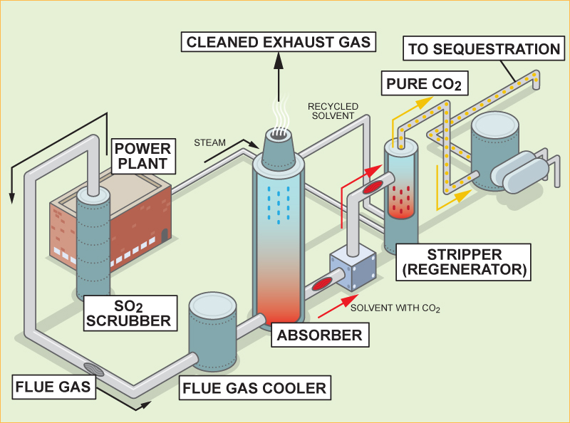
Post-Combustion Carbon Capture
Images: : Can Caputred Carbon Save Coal? Scientific American Earth 3.0
and http://www.coaltransition.org/filebin/images/diagrams/02_800_Post_Combustion.jpg
Notes:
Pros: Feasible to retrofit to current industrial plants and power stations.
Existing technology - 60 years experience with amine solvents - but needs 10x scale-up.
Currently in use to capture CO2 for soft drinks industry.
Cons: High running costs – absorber and degraded solvents replacement.
Limited large scale operating experience.

Slide 4
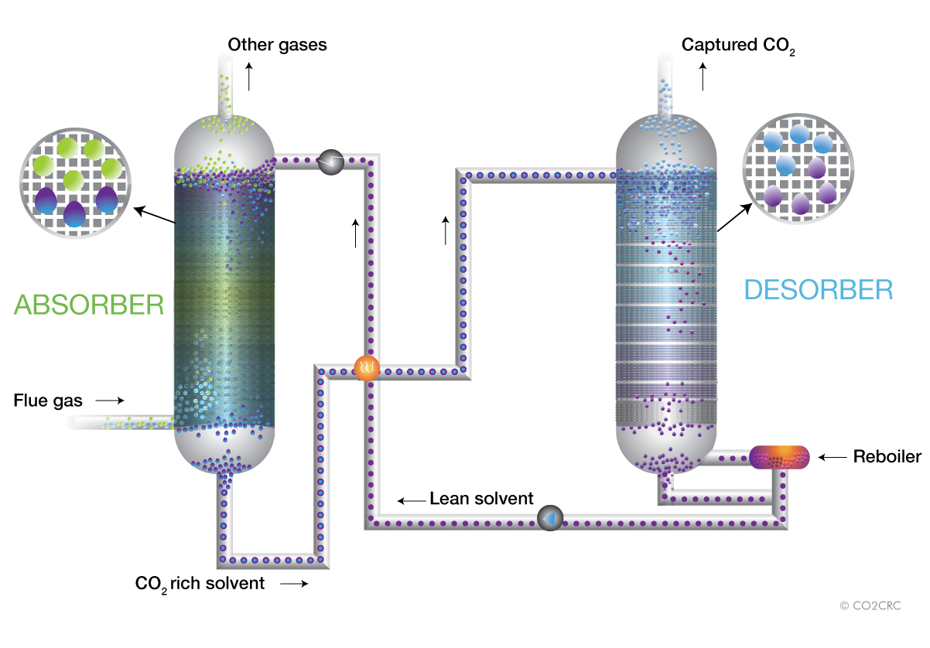
Solvent-based absorption CO2 capture
Image: http://www.co2crc.com.au/images/imagelibrary/cap_diag/solvent_absorption_media.jpg

Slide 5
Pre-Combustion Carbon Capture
Image: Can Caputred Carbon Save Coal? Scientific American Earth 3.0
Notes:
Pros: Proven industrial scale technology in oil refineries, but needs 3x scale-up for power plants.
90-95% of CO2 emissions can be captured.
Applicable to natural gas, and to coal fired IGCC power plants.
Lowest technology risk, and may become the most efficient method.
Can produce H2 as transportable energy vector, or liquid fuels from coal - but penalties on efficiency.
Cons: Requires a chemical plant in front of gas turbine.
High investment cost of dedicated new-build plant.
High NOx emissions – will require expensive scrubbers.
Efficiency of H2 burning turbines is lower than conventional turbines.
May be less flexible under varying electicity generation market requirement, so base load preferred.

Slide 6
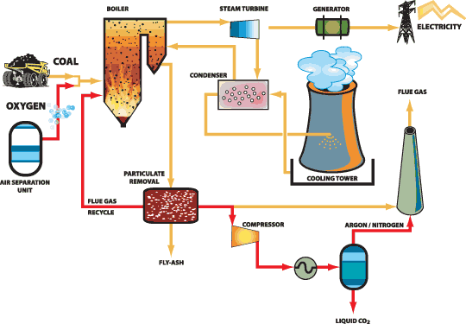
Oxy-Fuel Combustion Carbon Capture
Images: http://www.ccsd.biz/factsheets/images/oxyf_chart.gif
And: Can Caputred Carbon Save Coal? Scientific American Earth 3.0
Notes:
Pros Potential for 100% CO2 capture.
Few other harmful emissions due to more complete combustion.
May be possible to retro-fit the oxy-fuel burners onto modified existing coal power plant
Cons: High energy penalty without chemical looping combustion.
Only at large development stage at present - first demonstration plants recently commenced operation.

Slide 7
Schwarze Pumpe
30MW Oxy-Fuel Demonstration Plant
Image: Can Captured Carbon Save Coal? Scientific American

Slide 8
Global Storage Potential
Image: Global Energy Technology Strategy: Addressing Climate Change, May 2007

Slide 9
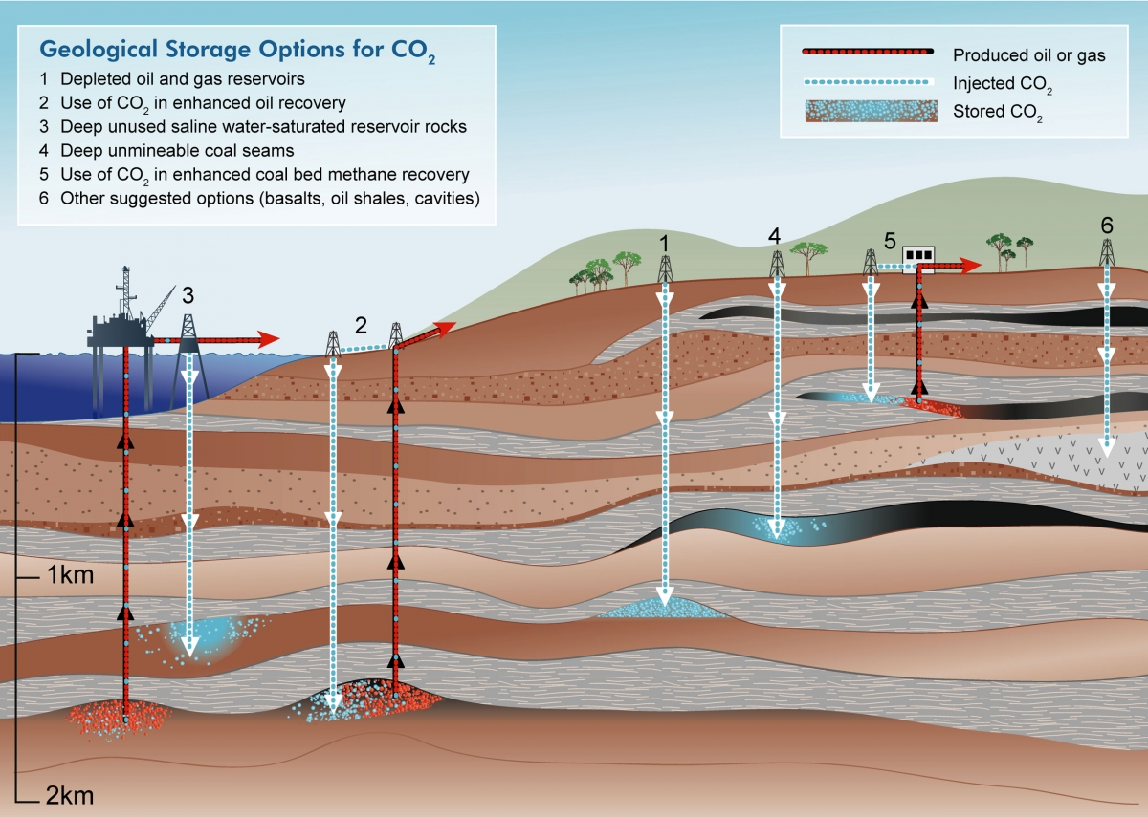
Storage Options
Depleted Oil and Gas Reserves / Deep Saline Reservoirs / Unminable Coal Beds / Deep Ocean Storage
Image: http://www.bigskyco2.org/sites/default/files/images/figures/geol_storageoptions.jpg

Slide 10
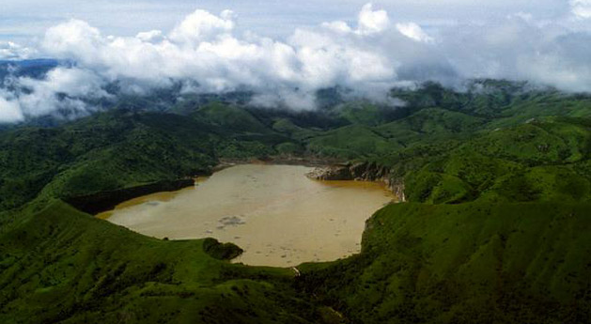
Lake Nyos, 1986
Image: http://www.wired.com/images/article/full/2008/08/lake_nyos_630px.jpg
Notes:
Lake Nyos is one of only three lakes in the world known to be saturated with carbon dioxide—the others are Lake Monoun, also in Cameroon, and Lake Kivu in Rwanda. A magma chamber beneath the region is an abundant source of carbon dioxide, which seeps up through the lake bed, charging the waters of Lake Nyos with an estimated 90 million tonnes of CO₂.
Lake Nyos is thermally stratified, with layers of warm, less dense water near the surface floating on the colder, denser water layers near the lake's bottom. Over long periods, carbon dioxide gas seeping into the cold water at the lake's bottom is dissolved in great amounts.
Most of the time, the lake is stable and the CO₂ remains in solution in the lower layers. However, over time the water becomes supersaturated, and if an event such as an earthquake or landslide occurs, large amounts of CO₂ may suddenly come out of solution.
on August 21, 1986, a limnic eruption occurred at Lake Nyos which triggered the sudden release of about 1.6 million tonnes of CO₂; this cloud rose at nearly 100 kilometres (62 mi) per hour.^{[4]} The gas spilled over the northern lip of the lake into a valley running roughly east-west from Cha to Subum, and then rushed down two valleys branching off it to the north, displacing all the air and suffocating some 1,700 people within 25 kilometres (16 mi) of the lake, mostly rural villagers, as well as 3,500 livestock. The worst affected villages were Cha, Nyos, and Subum
Carbon dioxide, being about 1.5 times as dense as air, caused the cloud to "hug" the ground and descend down the valleys where various villages were located. The mass was about 50 metres (164 ft) thick and it travelled downward at a rate of 20–50 kilometres (12–31 mi) per hour. For roughly 23 kilometres (14 mi) the cloud remained condensed and dangerous, suffocating many of the people sleeping in Nyos, Kam, Cha, and Subum.^{[4]} About 4,000 inhabitants fled the area, and many of these developed respiratory problems, lesions, and paralysis as a result of the gases.^{[11]}
It is not known what triggered the catastrophic outgassing. Most geologists suspect a landslide, but some believe that a small volcanic eruption may have occurred on the bed of the lake. A third possibility is that cool rainwater falling on one side of the lake triggered the overturn. Whatever the cause, the event resulted in the rapid mixing of the supersaturated deep water with the upper layers of the lake, where the reduced pressure allowed the stored CO₂ to effervesce out of solution.
It is believed that about 1.2 cubic kilometres (0.29 cu mi) of gas was released.^{[12]} The normally blue waters of the lake turned a deep red after the outgassing, due to iron-rich water from the deep rising to the surface and being oxidised by the air. The level of the lake dropped by about a metre and trees near the lake were knocked down.
EXAMPLE:
Carbonated water is a supersaturated solution of carbon dioxide gas in water. At the elevated pressure in the bottle, more carbon dioxide can dissolve in water than at atmospheric pressure. At atmospheric pressure, the carbon dioxide gas escapes very slowly from the supersaturated liquid. This process may be accelerated by the presence of nucleation sites within the solution, such as small bubbles, caused by shaking the bottle, or another solute, such as sugar powder or a widget.

Slide 11
Risks

Slide 12
What else?
Mineral Carbonation – its extraordinarily expensive (50-100 $/tCO₂) but sounds interesting!

